Slide 1
Network with TCP/IP
Overview for Interviews Cont’d

Slide 2
AGENGA
What is a process ?
Client – Server Model of communication.
What is Server ?
What is Client ?
What are Host,DTE ,DCE,Node?
Illustration of Host(TCP/IP layers)
NIC/Network Adaptor/Network Card
Illustration of Host to Host Connectivity thru TCP/IP

Slide 3
Client Server Models
Process is a running instance of a program.
For any two processes to communicate which each other , using TCP/IP protocol suite , whether they are available on the same system/device or two separate devices with same LAN or WAN or Internet MUST follow the client-server models for communication.
Server Process is that which provides service upon request from client.
It is supposed to run first and should always be infinitely running unless system shutdown or process aborted.
It is said to be passively open as long as no request is being served by it towards any client.
It becomes active open upon any client’s requests made and is serving that client and remains in that state.
It becomes passive open again when no clients are being served it.

Slide 4
Client Process is that which initiates/opens communication with server , takes service from it until desired and terminates/closes communication with server.
When Client opens communication with server and along as taking service from it is said to be active open.
When client closes communication with server it said to be active close.
Client should be finite process.

Slide 5
Few Client server Models
One Server serving One Client
One Server serving Multiple Clients ,where clients are communicating with server without regard/concern of each other.
One Server is acting as a mediater between two or more clients communicating with each other.
One Server behaves as a client wrt another Server to provide service to a client.

Slide 6
Host : Any system/device which runs a client process/server process/both.
DTE (Data Terminal Equipment) : End points in any communication network .
DCE (Data Communication Equipment) : Intermediate devices which facilitate communication directly or indirectly between two or more DTEs.

Slide 7
Node :
Any device which is part of the TCP/IP network is generically referred to as a node.
Hence Host/DTE/DCE are all nodes.
A Host may be DCE/DTE.
Every DCE/DTE is not a Host.

Slide 8
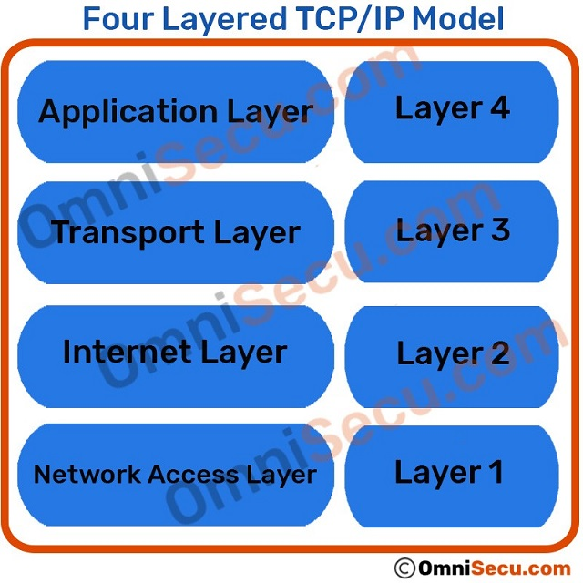

Slide 9
NIC :
Network Interface Card/Network Interface Controller/Network Adaptor refers an embedded system through which another system can associate/connect physically to be part of some network.

Slide 10
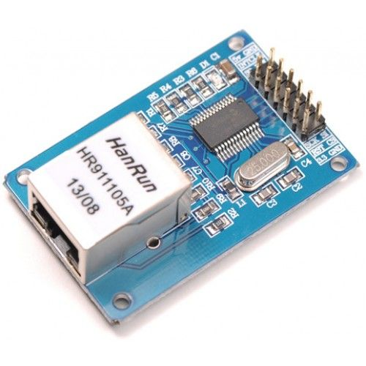
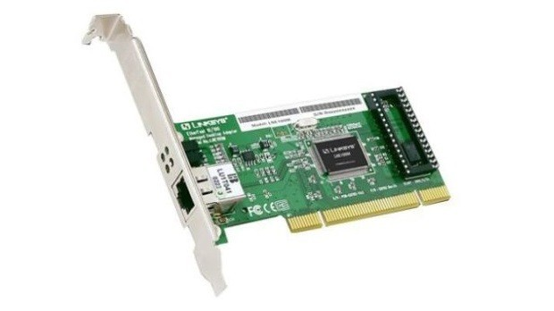
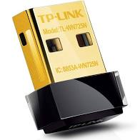
NIC/Network Adaptors

Slide 11
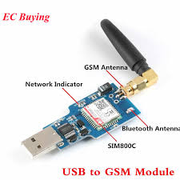
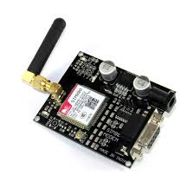
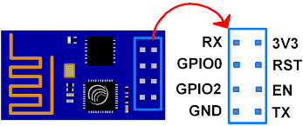
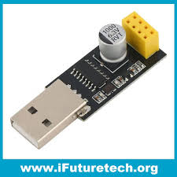
NIC/Network Adaptors

Slide 12
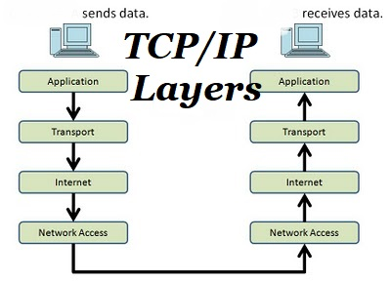
Host to Host Connectivity

Slide 13
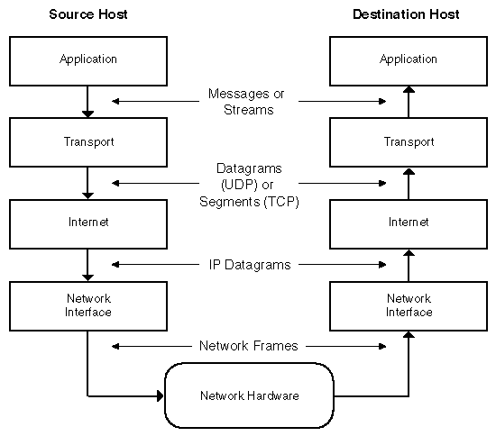

Slide 14
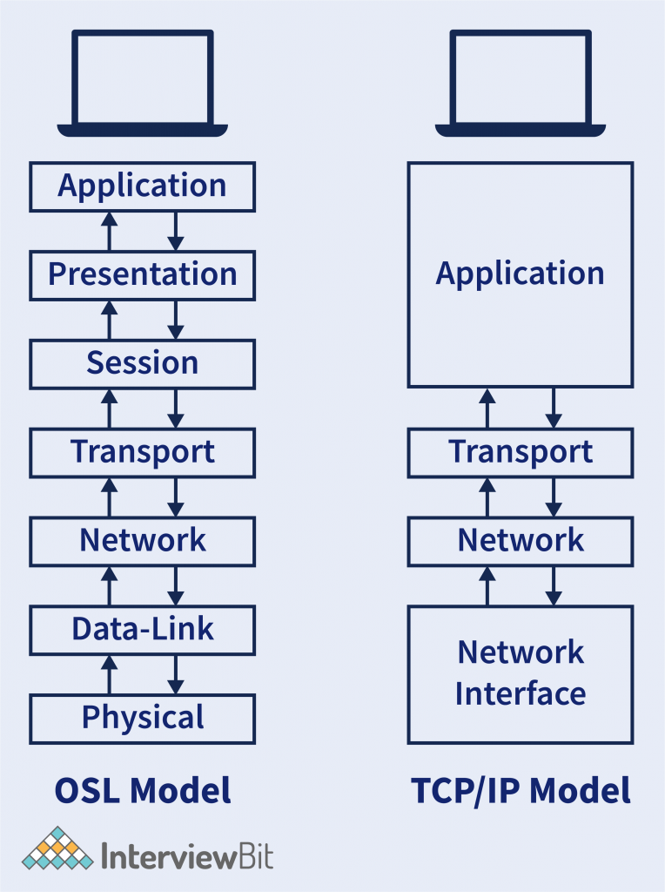

Slide 15
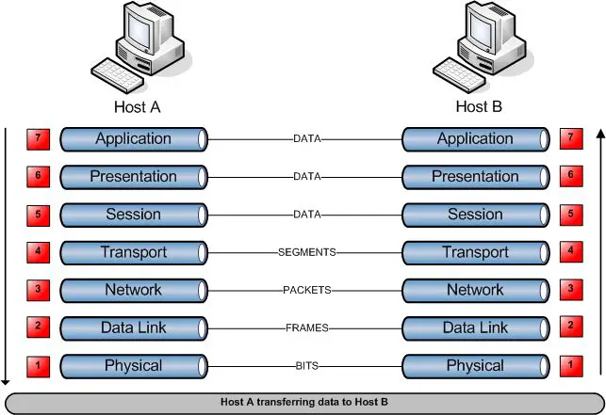

Slide 16
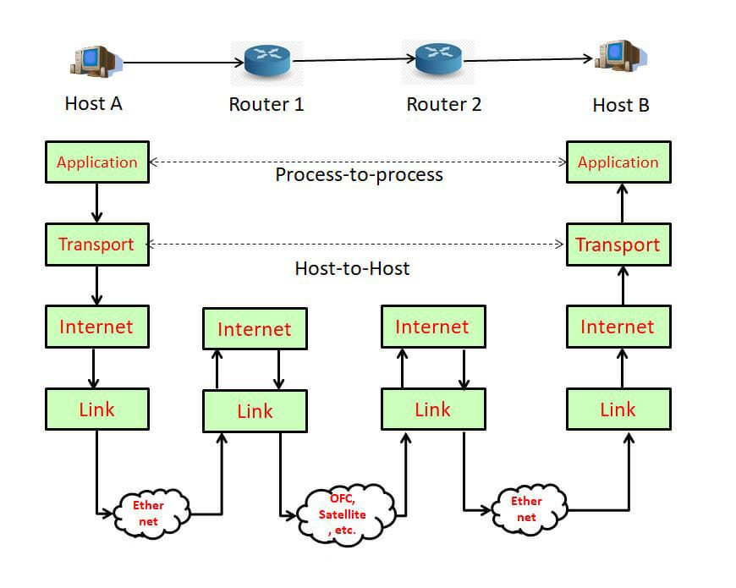

Slide 17
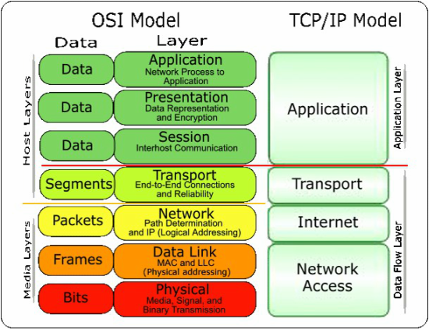

Slide 18
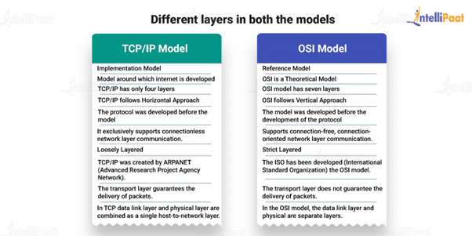

Slide 19
